Slide 1
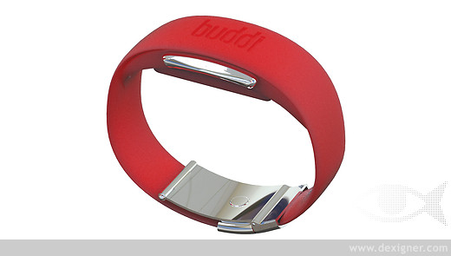
What is this used for?

Slide 2
It’s a thing called a buddiband!
Detects changes in typical activity levels
Alert about falls
Provides online monitoring for carers

Slide 3
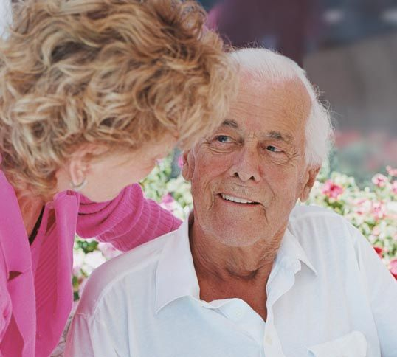
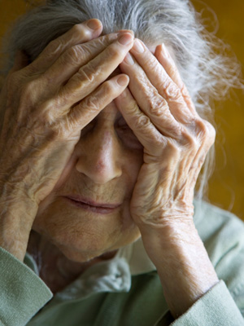
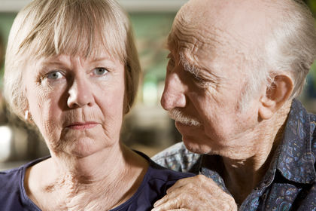
Helping those living with dementia

Slide 4
Lesson objectives
Appreciate the experiences and difficulties of being a carer
Recognise the support available for a carer
Know the purpose of assistive technology and how it can support health problems

Slide 5
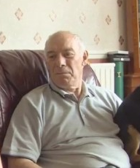
Task 1 - We met Jim in the last lesson, what were his problems?

Slide 6
http://www.nhslocal.nhs.uk/story/features/dementia-schools-teaching-aid-part-2-0

Slide 7
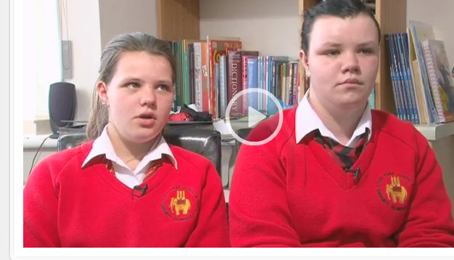
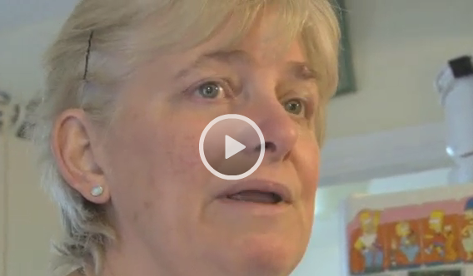
Task 2 - How are the carers who look after Jim, his wife and his grandchildren affected by his dementia?

Slide 8
Task 3 – If the girls were your friends how would you support them?

Slide 9
Problems faced by those with dementia
Finding things
Remembering to do jobs
Remembering if jobs have already been done
Using the telephone or appliances
Finding the way around at home and out
Recognising people
Knowing who they are, where they are or where they have been
Remembering to eat meals
Remembering to take medication
Falling

Slide 10

Task 4 – Using the fact sheet and the information on the power point choose a solution for each problem
PROBLEMS
SOLUTIONS

Slide 11

Dementia dog
http://dementiadog.org/dementia-dog-%E2%94%82-videos.html

Slide 12
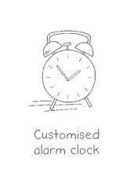

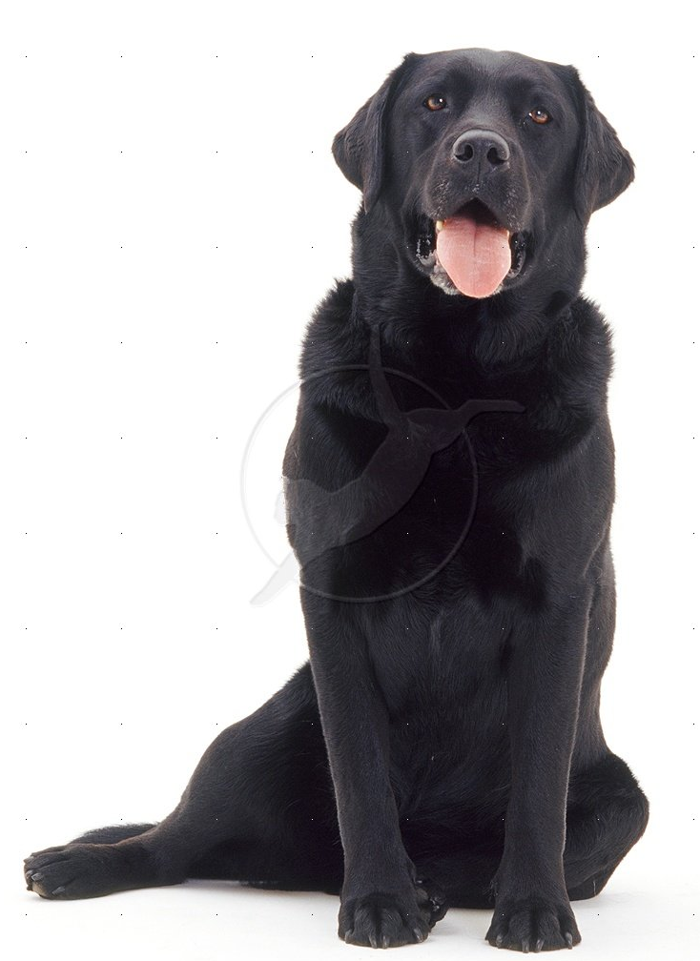
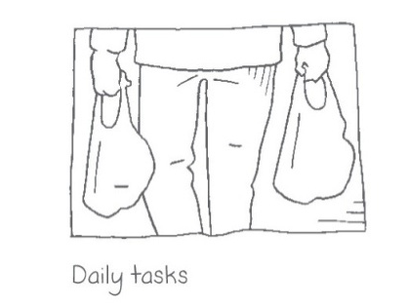


Slide 13
Buddiband
A wristband personal alarm that people will be happy to wear and can send alerts from anywhere to buddi's support services. The buddiband is comfortable, discreet and waterproof.
Manual emergency alert: Responses handled by buddi's 24/7 emergency response centre.
- Automatic fall alert: If a user has a fall the wristband detects it and calls for assistance.
- Lifestyle monitoring: Detecting shifts in typical activity levels. If a user's activity levels significantly diminish, contact is made with the user or carer.
- Online monitoring: Allowing carers to keep an eye on activity levels without being present.
http://player.vimeo.com/video/40509919

Slide 14
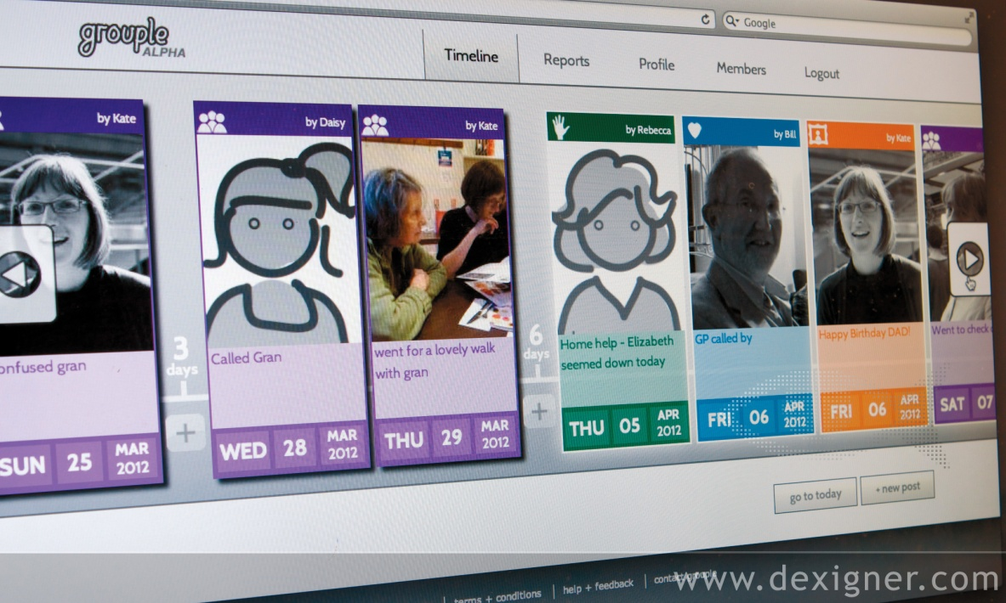
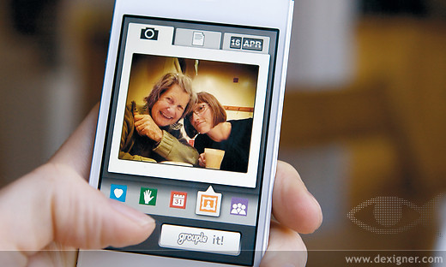
Grouple
http://vimeo.com/40510893
At the centre of each Grouple hub is a timeline. Members can post items such as visits, appointments, observations and questions, quickly seeing and filling in gaps in the schedule. Care decisions can easily be discussed and informed by everyone's observations. Printed reports can also be created based on timeline content. This will assist medical professionals and help update family members who are offline.

Slide 15
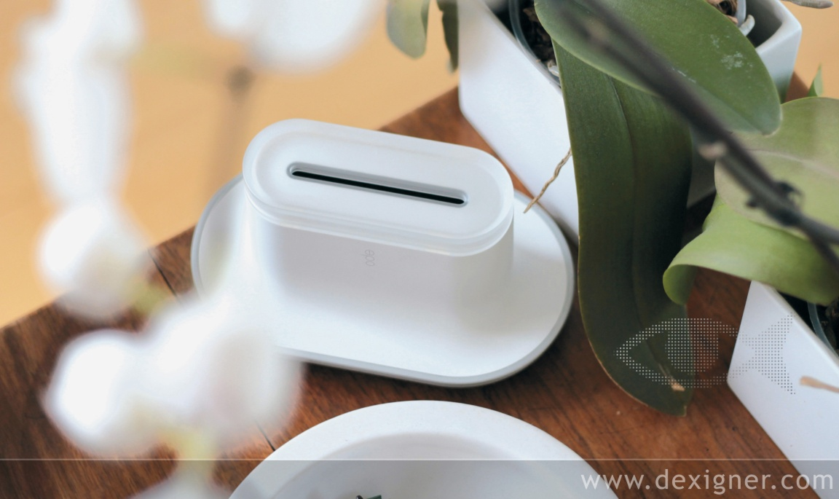
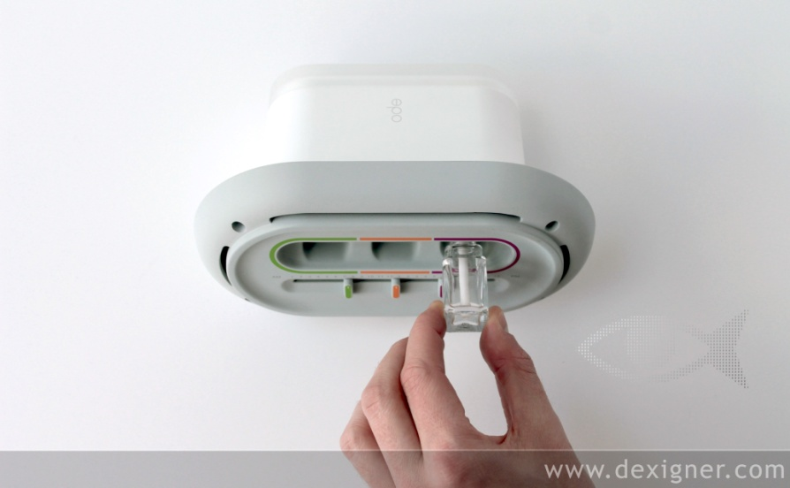
Ode
A fragrance-release system designed to stimulate appetite among people with dementia. The mains-powered unit releases three food fragrances a day, adjustable to coincide with the user's mealtimes.
http://vimeo.com/40511635

Slide 16
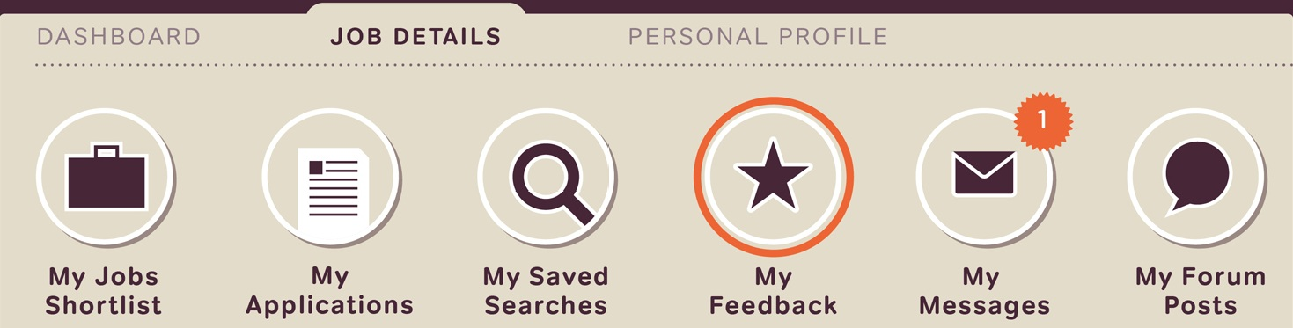
Trading times
Carers will complete a simple profile describing their work skills and enter the number of hours they think they can work. A local community manager will welcome every new carer with a telephone call to help them on their way. Employers will either post short job adverts or search for local carers with relevant profiles.
http://vimeo.com/40513087

Slide 17
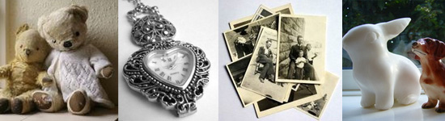
Memory boxes
Typical items to put in the box could be photographs of family gatherings, weddings etc. , small toys, pieces of jewellery, tickets/programmes to the cinema/football, tools that were used by the person perhaps in their professional life, items associated with family members like baby shoes/glasses/small items of clothing.
something that has an interesting texture like a toy or some fabric or something that can be held and moved around in the hand or a familiar aroma like a favourite perfume. And don't forget how evocative sound can be, so perhaps a tape or cd with favourite music or familiar voices or the sound of a familiar place like the seaside. The choice is yours. Every box will be different and unique.

Slide 18
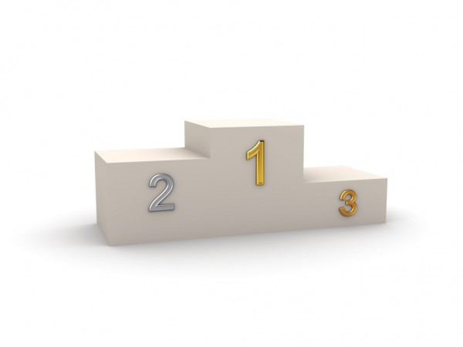
Task 5 - The podium– what are the three best ideas?

